Slide 1
Online Airline Reservation System
Nishu Akter
ID:UG02-48-18-017
State University Of Bangladesh
Department Of Computer Science And Engineering

Slide 2
Outline
1.INTRODUCTION
2.LITERATURE REVIEW
3. PROPOSED METHODOLOGY
5.FRONT END DEVELOPMENT
6. BACK END DEVELOPMENT
7.OVERVIEW
8.CONCLUSION AND FUTURE WORK
9.ACKNOWLEDGMENT
10.GREETINGS

Slide 3
Introduction
Travel booking forms also known as travel reservation forms are used by travel agencies to help book travel for clients. Clients can provide details about the number of attendees, arrival and departure dates, and important travel demands all at once, eliminating the need for back-and-forth phone calls and email.This project is designed with the purpose of providing all potential travelers with the virtual and necessary information..we are intermediary between travelers who would like to buy the ticket to go in some place for any reason and all airlines which give the service of transportation to the whole world.

Slide 4
Literature review
The online booking companies have to provide the service should be provided as per the desire of the passengers and the companies have to maintain the secrecy in respect of passengers personnel information “E-ticketing as a new way of buying tickets” try to focus on the motivational factors that influence online buying. Airline reservation systems are used to maintain records of flight schedules and passenger reservations and seat assignments and ticket purchases. The modern airline reservation system also serves customer needs from beginning to end of each customer’s reserved flight, therefore laying out management tasks for each flight. airlines created their own systems for ticket booking and management. Today, many brands co-operate with the world airlines companies for user-friendly direct systems, increased productivity and efficiency.

Slide 5
Proposed Methodology
This research work is centered on the design and implementation of airline ticket seat reservation system for Airline. It is meant to design a system that will automatically generate seat numbers for passengers. we complete requirements specification based on our analysis.
We then plan on exactly what has to be achieved at the end of the project. We then proceed to the design phase where we determine how the goals set for there going to be met and how the deliverables are going to be achieved.
This will be done by making a blueprint for the design phase to help the group members have a fair idea of what is expected of the system.

Slide 6
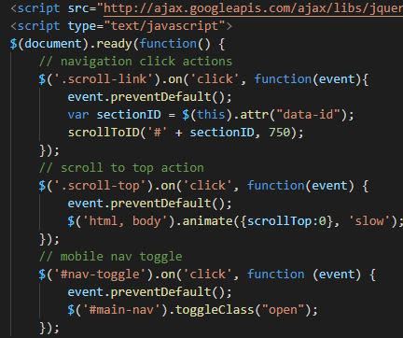
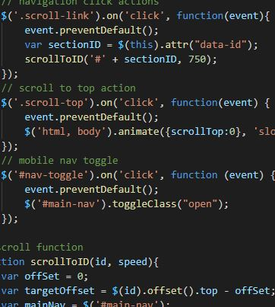
Front End Development
The code was mixed with the using html(hyper text mark up language) css(sytle sheet) language used for describing the look and formating a document written in mark-up language.We also introduced bootstrap program in our application

Slide 7
BACK END DEVELOPMENT
The Database Management System provides support
for the back end.The database management system
is essentially software where we can create the
database,add,drop,update,cancellation.
In our application we have chosen the MySQL DBMS t0hold the database.MySQL is a relational database management system

Slide 8
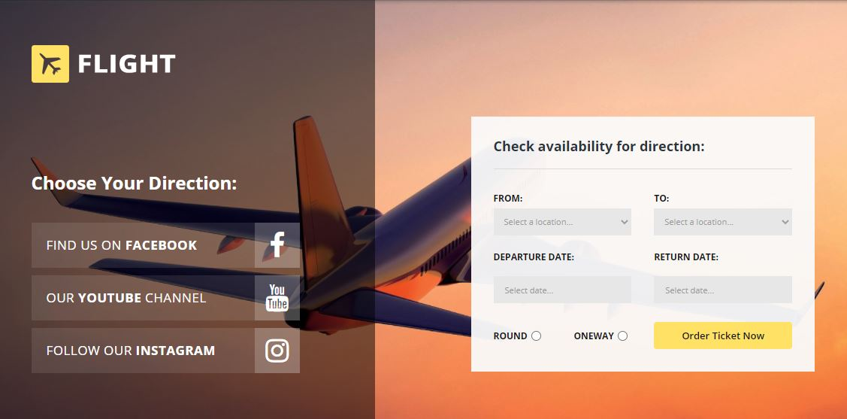
OVERVIEW

Slide 9
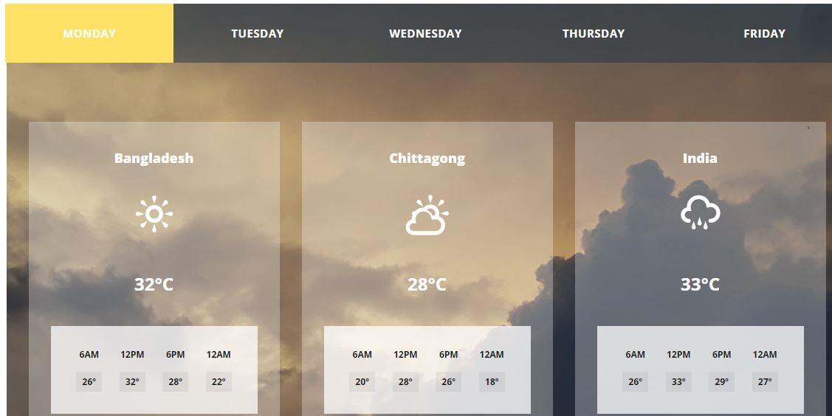
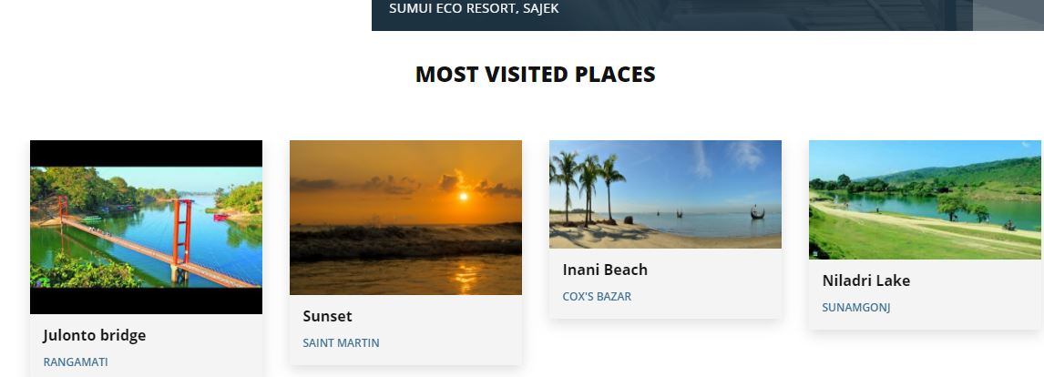
OVERVIEW

Slide 10
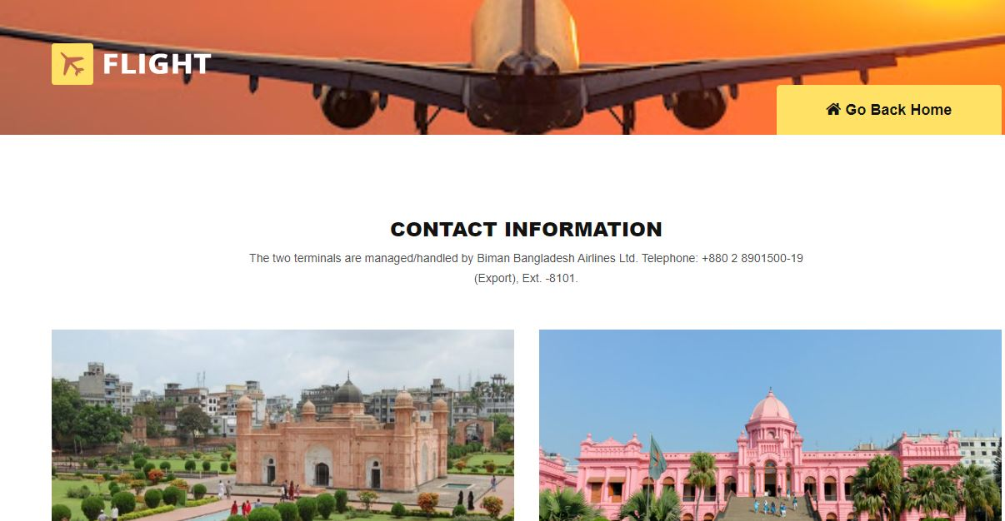

Slide 11
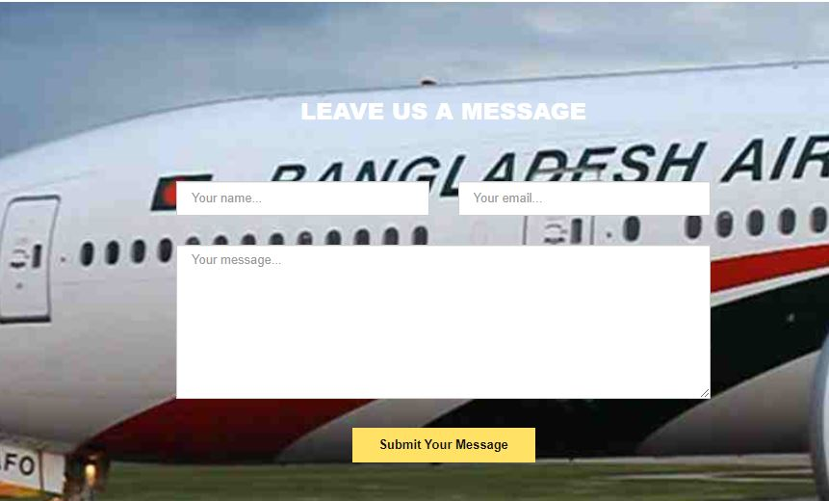

Slide 12
Conclusion and future Work
Online ticket booking system has been developed successfully. To provide online enquiry about the flights, fare and waiting list status To perform cancellation of tickets by accepting PNR number from the user and print the refund receipt.Updating seat plan and verification

Slide 13
Acknowledgment
I would like to thank my honourable khan.Md.Hasib Sir for his time, generosity and critical insights into this project.

Slide 14


